Slide 1
Person ReID

Slide 2
Introduction
to Person re-identification

Slide 3
Introduction of a Person Re-identification
To determine whether some images belong to the same subject or not.
Usually captured by two cameras with disjoint views.
Similar to biometric recognition problems(e.g., face recognition)
The core is to find a good representation and a good metric to evaluate the similarities.
Notes:
Intra-class variation 설명 넣기

Slide 4
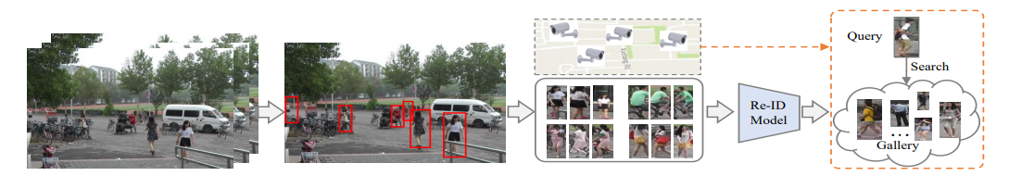
The flow of a practical ReID System
Raw Data Collection.
Bounding Box Generation
Training Data Annotation
Model Training
Pedestrian Retrieval (The testing phase conducts the pedestrian retrieval.)
Notes:
서베이 논문 참고

Slide 5


The challenges of a ReID System
Different viewpoints
Varying low-image resolutions
Illumination changes
Occlusions
Heterogeneous modalities
Background clutter
Unreliable bounding box generations
Unconstrained poses & Changing cloths
Intra-class variation
Notes:
서베이 논문 참고

Slide 6
Related works

Slide 7
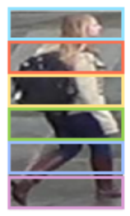
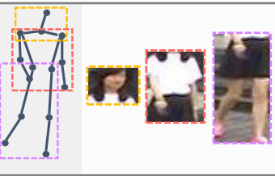
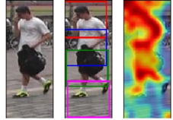
Part-based Methods
Mainly focused on:
distance metric learning with feature representation learning.
extra auxiliary information to enforce more supervisions.
pedestrian alignment and part matching to leverage on the human structure prior.
Assumption:
sufficient annotated data and correct annotation exists
Notes:
DG-NET 논문 Related Work의 내용
DG-NET이 Encoder – GAN을 활용한 시초로 보임
Pose-Normalized Image Generation for Person Re-identification 논문 related work 파란색 블록에 기존의 pose-guided based on body part detection 설명 나옴

Slide 8
Generative Frameworks
Auto Encoder
GAN
Nonlinear dimensionality reduction
Representation learning
Manifold learning
Smooth and Blurry image quality.
After fitting, the encoder can be used for feature extraction. Unfortunately, the decoder can’t be used as generative model.
To force the output to be indistinguishable from real photos.
Based on a minimax game rather than an optimization problem
Sharp and Artifact image quality.
Notes:
AE의 목적은 새로운 데이터의 생성이 아닌, 복원이기 때문에, latent 값에 수정을 하게 될 경우 그에 상응하는 결과를 만들 수 있다는 가정이 없음. 따라서 GAN이 필요함.
GAN은 Mode collaps가 일어나는데, gan의 목적은 오직 현실적인 결과를 내놓는 것일뿐 다양한 샘플을 만드는것은 아니기 때문에, AE가 필요함.
디코더를 생성모델로 사용할 수 없는 이유: `This is because the encodings E(X) are not constrained to a smooth, well-behaved distribution`

Slide 9
AEGAN
Stabilizing GAN training by directing the generator towards the low-dimensional manifold in high-dimensional pixel space.
Mitigating mode collapse by requiring that the generator be able to reproduce the training dataset.
To allow for direct interpolation between real samples.
GAN
AE or VAE
비관심 정보
Encoder 1
Decoder
or
Generator
Discriminator
관심 정보
Encoder 2
Reconstruction(+KL Divergence)
Loss
Adversarial Loss
Identity Loss
AUTOENCODING GENERATIVE ADVERSARIAL NETWORKS, April 14, 2020
Notes:
1. GAN 안정화: Random z에서 생성 하는것 보단, low-dim 다양체에서 생성하는게 더 쉬움.
2. Recon loss 때문에 사실적이기만 한 결과가 아니라, 입력과 동일한 출력이 목적으로 추가돼서 mode collapse 없음.
3. 첫째와 두번째로 인해 명확하게 latent variable을 사칙연산 하여도 작동함.

Slide 10
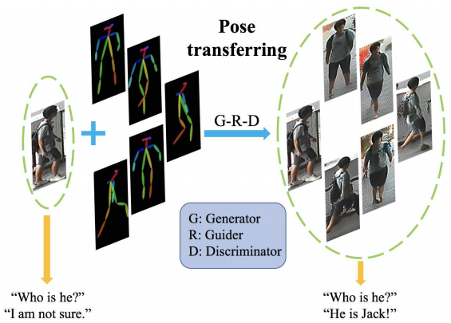
Data Argumentation Methods
Inspired by the image translation tasks.
Addressing the lack of cross-view data and the influence of pose variations.
Synthesizing realistic person images conditional on pose.
Other auxiliary pose information and multiple datasets required.
Pose-Normalized Image Generation for Person Re-identification, April 25, 2018
Pose Transferrable Person Re-Identification, Dec 17, 2018
Notes:
Disentangling factors of variation in deep representations using adversarial training논문이랑 DG-NET논문 참고해서 만듦.
DG-NET논문 3페이지: Meanwhile, some recent studies also exploit synthetic data for style transfer of pedestrian images to compensate for the disparity between the source and target domains. CycleGAN is applied in to transfer pedestrian image style from one dataset to another. => 스타일 변환을 통해 도메인 Adaptation 시도가 있었음(CycleGAN으로 소스 dataset의 보행자 이미지의 스타일을 target 데이터셋의 스타일로 변경)

Slide 11
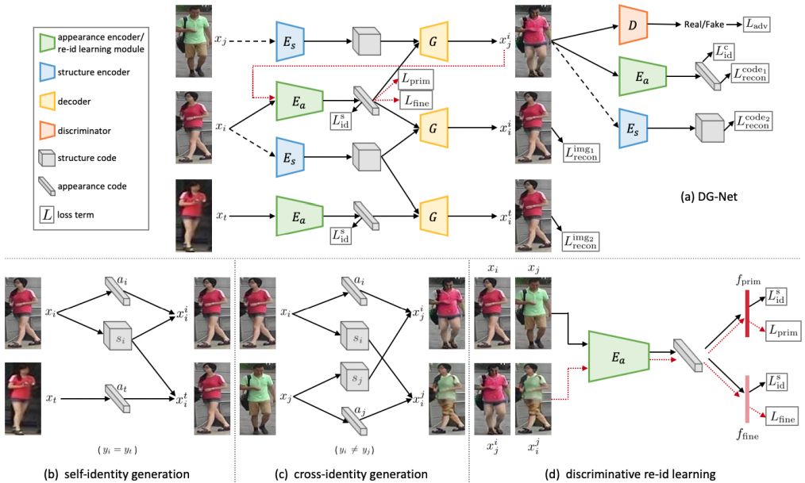
Disentangled Extraction Methods
Self-identity generation:
Image reconstruction using the same identity.
Identity shuffling to part-level features.
Cross-Identity generation:
Image generation with different identities.
No pixel-level ground-truth
Instead, Latent code reconstruction
Learning Disentangled Representation for Robust Person Re-identification, Nov 1, 2019
Joint Discriminative and Generative Learning for Person Re-identification, May 22, 2019

Slide 12
Cross Domain Adaptation

Slide 13
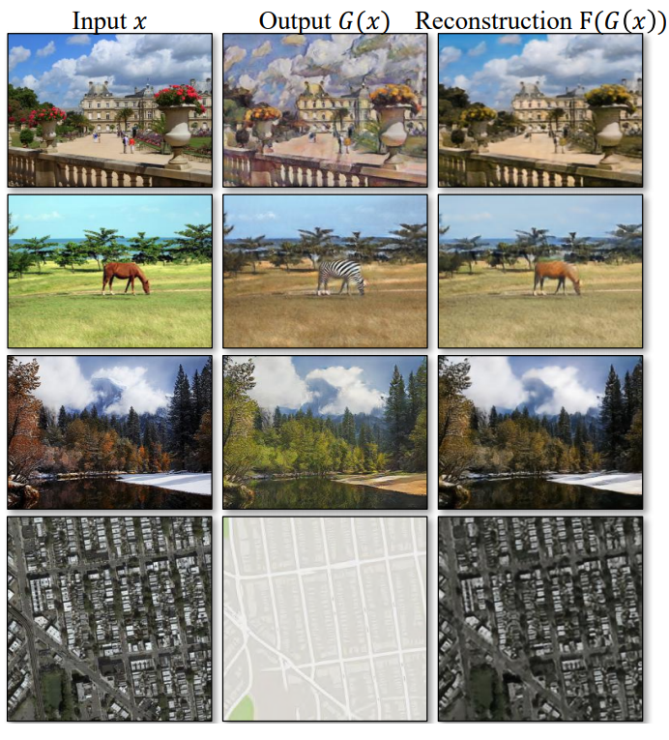
Cycle GAN
image-to-image translation
to learn the mapping between an input image and an output image in the absence of paired
mappings:
G : X → Y
F : Y → X
constrains:
G(X) ≈ Y
F(G(X)) ≈ X

Slide 14
Experiments

Slide 15
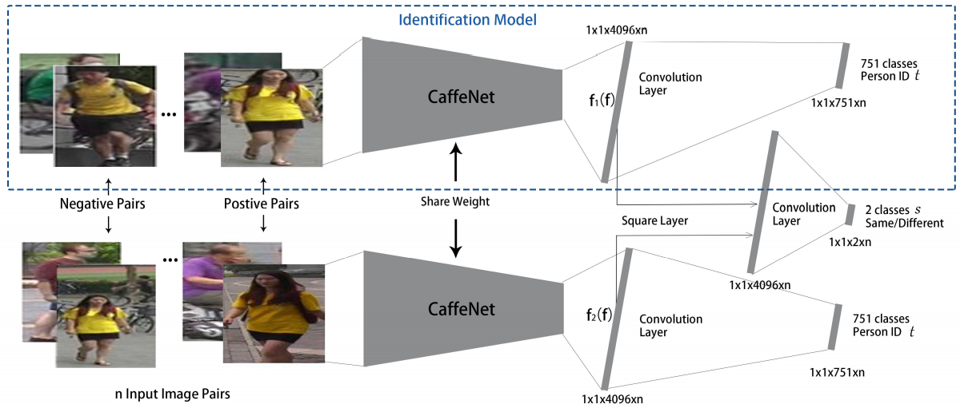
Baseline(ID-discriminative embedding)
A siamese network that simultaneously computes the identification and verification loss.
Sorting the cosine distance between the query and all the gallery features to obtain the final ranking result
A Discriminatively Learned CNN Embedding for Person Re-identification, 2016

Slide 16
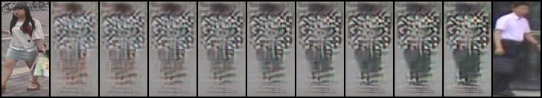
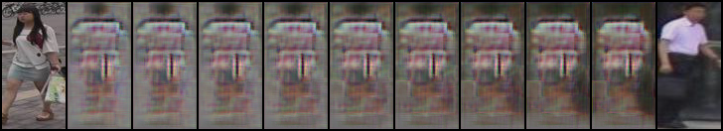
Visual Comparison

